Slide 1
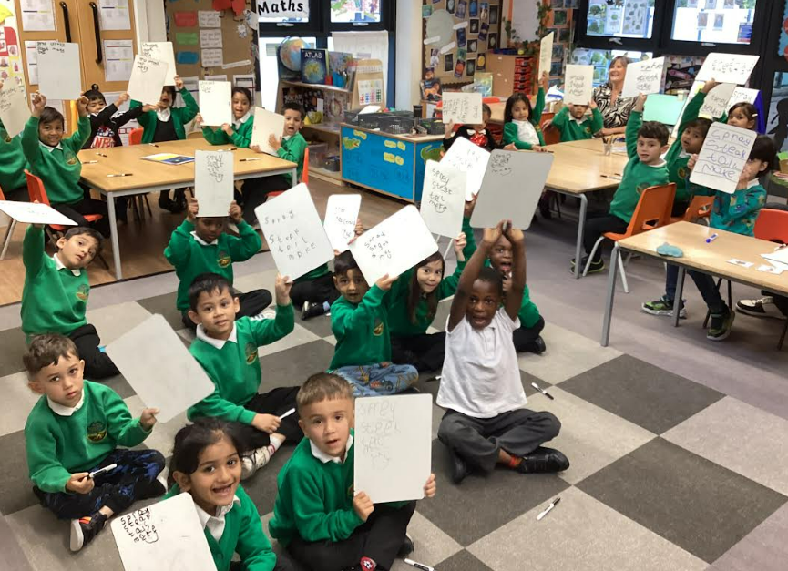
Welcome!

Slide 2


Slide 3
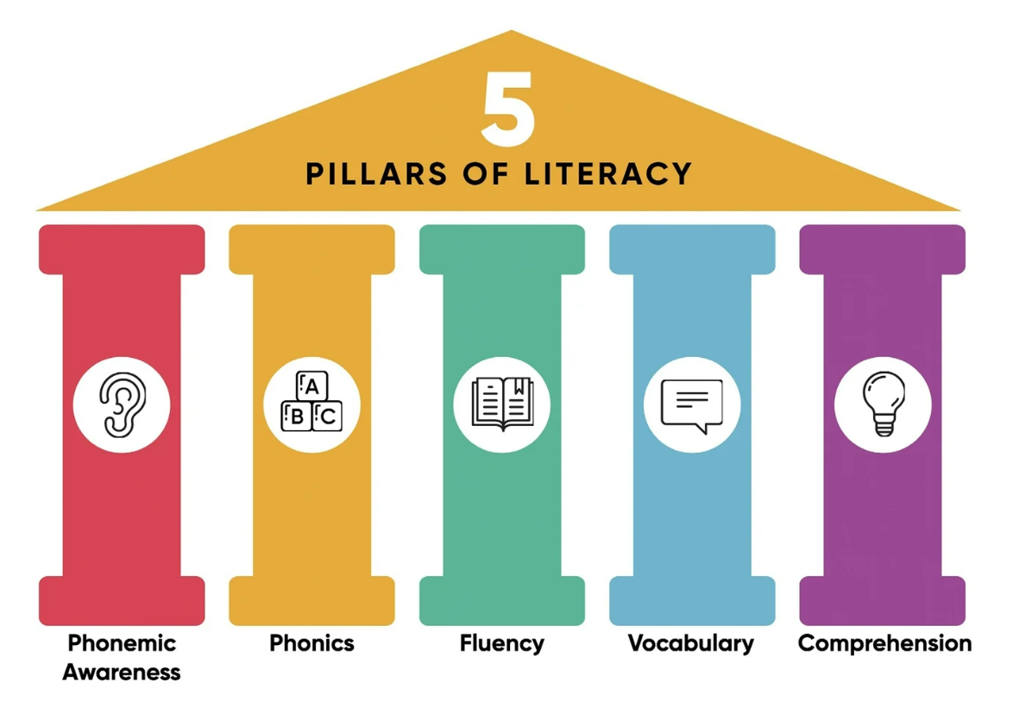

Slide 4
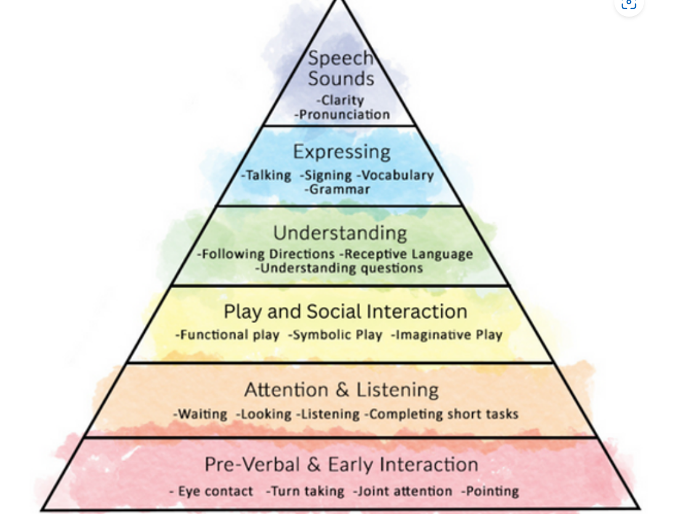

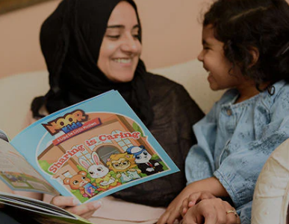
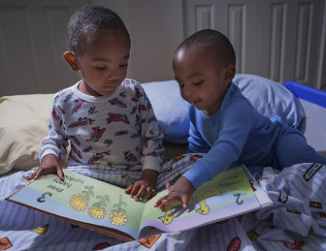


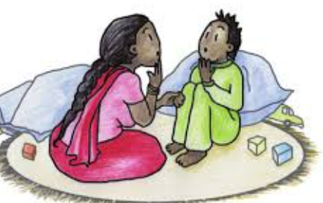



Learning to
read starts
from…birth! Nursery develops these skills further.
Pre-reading skills

Slide 5
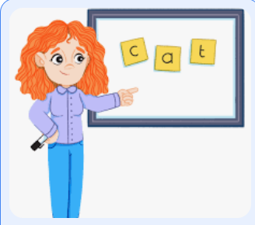


From the first day of Reception…
All children continue their journey to reading and spelling through focused, teacher-led phonics lessons.
Every child takes part in every lesson (they start at 9am, sharp!)
₊

Slide 7

We aim for children to be able to read with understanding and fluency.
By the end of Year 1, they should have enough ‘code knowledge’ to attempt most texts accurately- allowing us to focus more on…
Have a look on your tables for age-expected books.

Slide 8


Some children will find it hard/harder than others
The only way is to practise…
Reading TO your child every night at bedtime
Listening to them read their school book before they have their TV time
Using the same language as we use in school (coming up!)
Being supportive and calm when things are getting frustrating!
Keeping their attention focused
Pushing sounds together to ‘hear’ the word

Slide 9

We are a Sounds-Write school

Slide 10
Parent cheat sheet- key language
Encourage them to use their finger under the word from left to right:
“Use your reading finger please”
If they read a word incorrectly, ask them to:
“Say the sounds and listen for the word”
If they need more help say:
“I’ll say the sounds, you listen for the word.
What is the word?
Your turn- say the sounds and listen for the word ‘…’

Slide 11

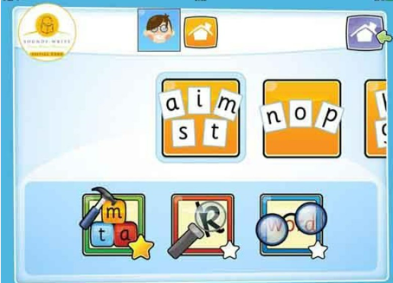
Look out for ‘Taster Mornings’ next year where you can see the children in action and take part yourself.
Search AppStore: Initial Code

